Slide 1
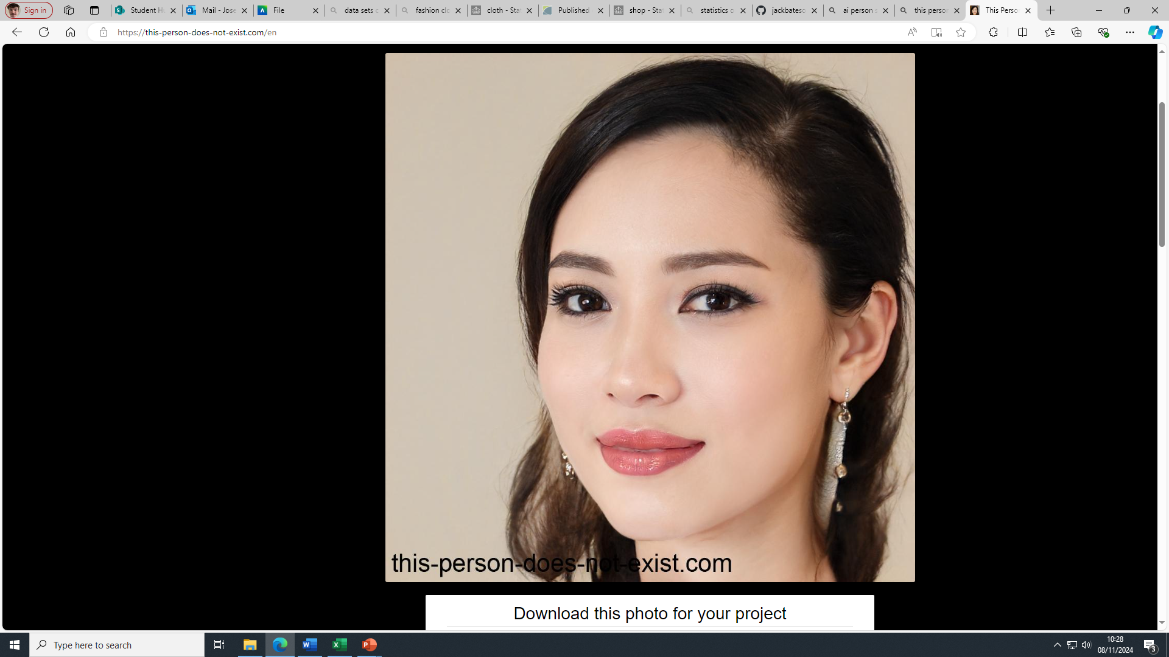
Persona: Sarah Thompson Age: 19 Background: First-year student studying Psychology Disability: Deaf since birth; fluent in British Sign Language (BSL) and skilled in written English Personality: Determined, resourceful, and tech-savvy. Sarah loves to stay connected and often seeks solutions to overcome accessibility barriers. She's enthusiastic about experiencing the world independently. Motivations: - Exploring campus with ease and confidence - Being informed of important visual cues or written instructions that enhance her understanding of the environment - Accessing detailed, real-time information without the need to rely on others or interpreters for navigation Technology Preferences: - Prefers apps with visual cues, captions, and text-based info over audio - Enjoys AR features that provide quick access to information by simply pointing her phone at a spot - Uses vibration or screen flash alerts for important notifications Daily Challenges: - Struggles with traditional audio tours or voice-based navigation apps - Experiences difficulty identifying places or following routes without visible, clear signposts or instructions App Expectations: - Easy-to-use AR functionality that shows text pop-ups with essential information, accessible through BSL translation or icon-based navigation when possible - High-contrast visuals and font options to improve readability - Customizable alerts for places of interest or guidance on the safest, most accessible routes around campus

Slide 2
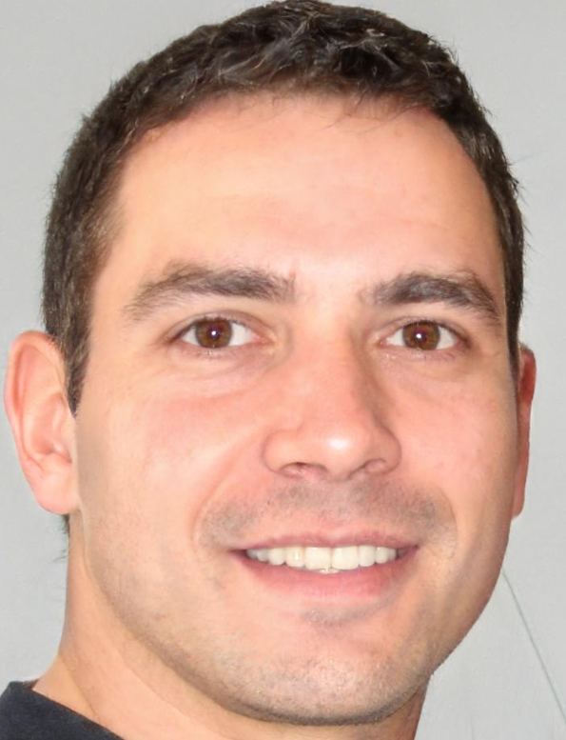
Persona: Mark Wilson
Age: 35
Background: Campus tour guide and accessibility ambassador; has been working at the university for 8 years
Personality: Friendly, patient, and detail-oriented. Mark is enthusiastic about making campus inclusive and accessible to everyone. He loves interacting with students and finding ways to make their university experience smoother.
Motivations:
- Ensuring all students, especially those with disabilities, feel confident navigating campus
- Providing up-to-date, accurate information about buildings and routes
- Improving campus accessibility for future students
Technology Preferences:
- Familiar with user-friendly software and app interfaces; comfortable with digital updates and AR features that allow him to see and test what students will experience
- Prefers intuitive systems with quick access for adding, editing, or flagging inaccurate location data
Daily Challenges:
- Ensuring he can quickly and easily update building information, such as temporary construction, new accessible entrances, or emergency instructions
- Keeping track of the latest accessibility features in each building and ensuring they are accurately reflected in the app
App Expectations:
- Easy-to-access edit mode for adding or updating building details, routes, and accessibility info in real time
- AR preview feature to see how updates look to students
- Notification feature to alert him to any flagged issues or accessibility requests from students

Slide 3
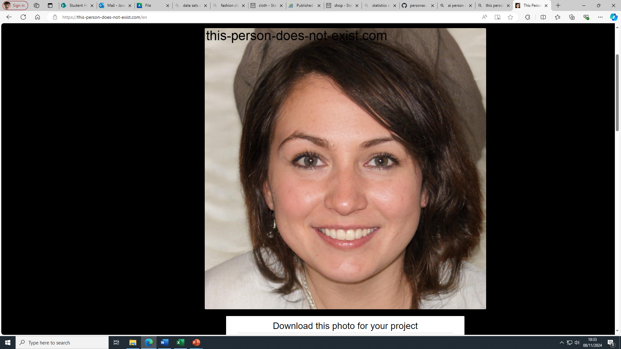
Persona: Dr. Emily Browne
Age: 42
Background: Senior Lecturer in History; has been teaching at the university for over 10 years but struggles with navigating the ever-expanding campus
Personality: Friendly, absent-minded, and a bit scatterbrained. Dr. Browne is known for her deep knowledge of history and her lively lectures but often finds herself confused by campus directions and building names.
Motivations:
- Making it to her lectures and meetings on time without relying on colleagues or students for directions
- Avoiding the embarrassment of arriving at the wrong building or classroom
- Keeping up with the changes on campus without having to memorize every update
Technology Preferences:
- Enjoys apps that are simple, straightforward, and don’t require too much setup
- Needs quick, reliable directions that she can follow without much fuss
- Prefers minimal notifications and wants only essential alerts
Daily Challenges:
- Frequently mixes up buildings with similar names and ends up at the wrong location
- Struggles to keep track of building updates, like when entrances change due to renovations
- Often asks students or other staff for help finding her way, which can disrupt her schedule
App Expectations:
- Clear, step-by-step navigation that shows her exactly where to go on campus
- Visual cues and building images that she can use to match locations
- Optional quick-reference feature that lets her “bookmark” frequently used buildings, lecture halls, and meeting rooms

